Slide 1
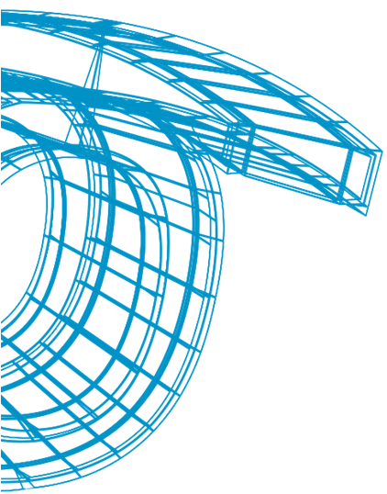

Interactive and Stereoscopic Hybrid 3D Viewer
of Radar Data with Gesture Recognition
^{Jon Goenetxea Imaz}
^{jgoenetxea@vicomtech.org}
Notes:
Presentación

Slide 2
Weather Radar Data Interactive 3D Viewer
Contents
Scope and Objectives
3D Representation
Gesture Interaction
Experimental Results
Conclusions and Future Work
Notes:
Comentar lo que se va a decir

Slide 3
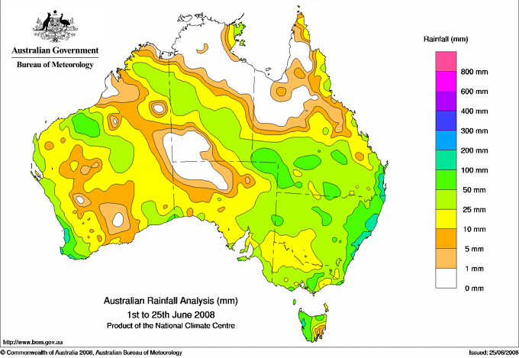
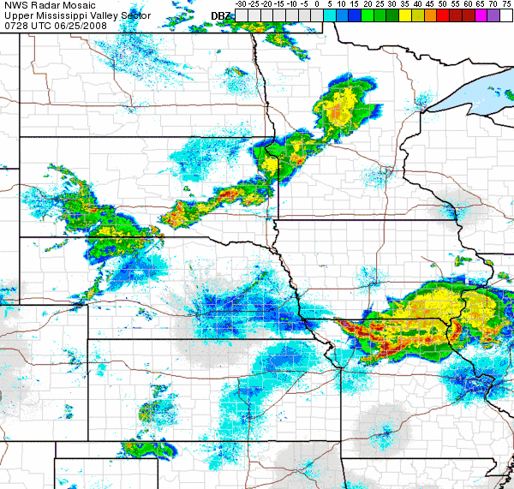
Scope
Radar data representation for meteorological analysis.
Notes:
This paper is based in the area of the meteorological analysis.
Nowadays, in this area, big amounts of radar data are analysed.
To represent this data 2D representations are used, some times like static images and others like animations.
But usually, the radars captures the information of a 3D space, and 2D images can’t represent all of this information.

Slide 4
Scope and Objectives
Objectives
Represent the weather data with a interactive and immersive hybrid 3D viewer.
Easy interaction between user and the represented scene using a gesture interface.
Notes:
The main objective is to represent the weather data like a immersive 3D scene.
In this way, is possible to represent the data captured in the radar station in a realistic way.
In the other hand, a easy interaction between user and scene is needed.
To achieve this, a gesture interface is proposed.

Slide 5


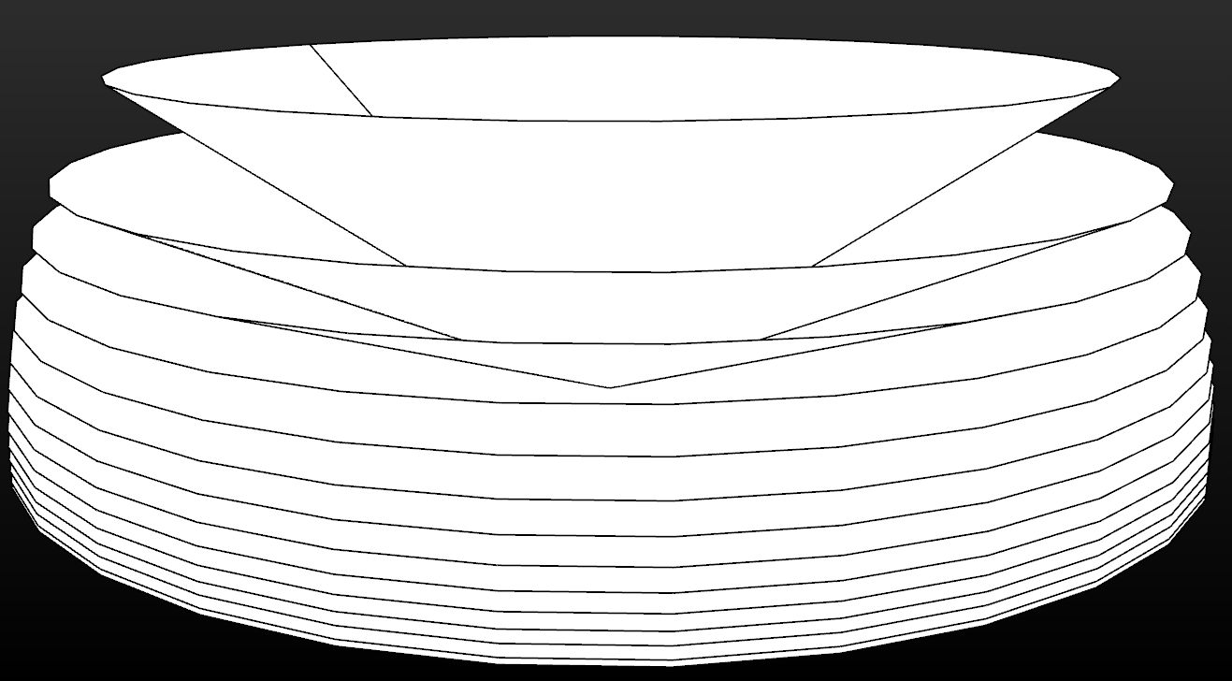
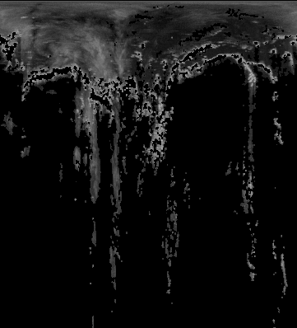
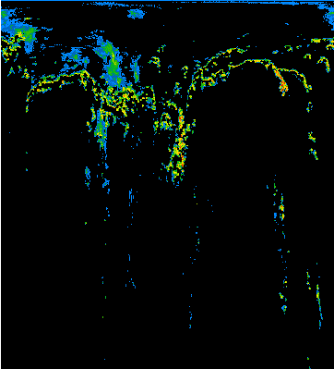
Representation and 3D visualization
Radar lectures representation
Notes:
In this implementation, a Doppler radar is used to capture the weather data.
This type of radar, takes the information doing different conical scans.
Each scan takes some information for the scanned area, as we can see in the picture.
Processing this data, we can get a 3D texture, which represents the clouds density.
We can colour this texture using a RGB colour scale.

Slide 6
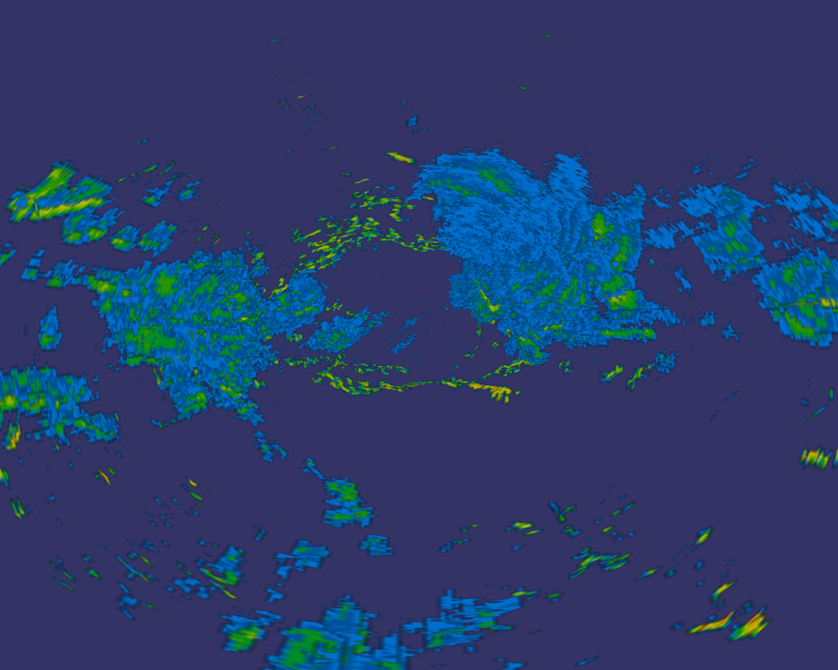
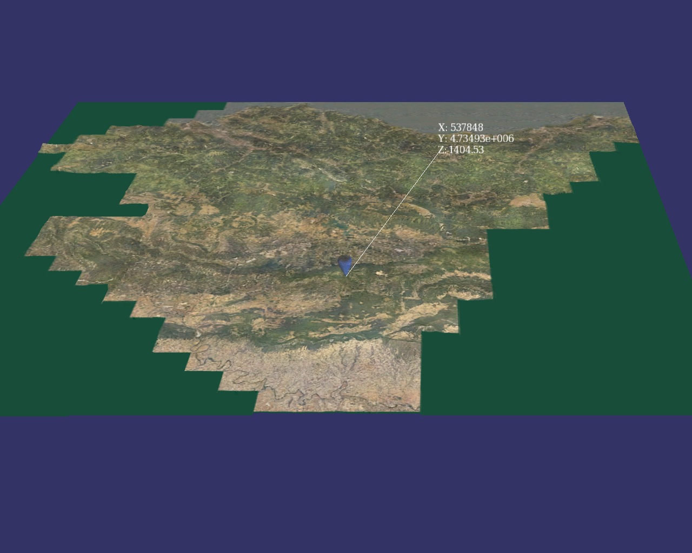
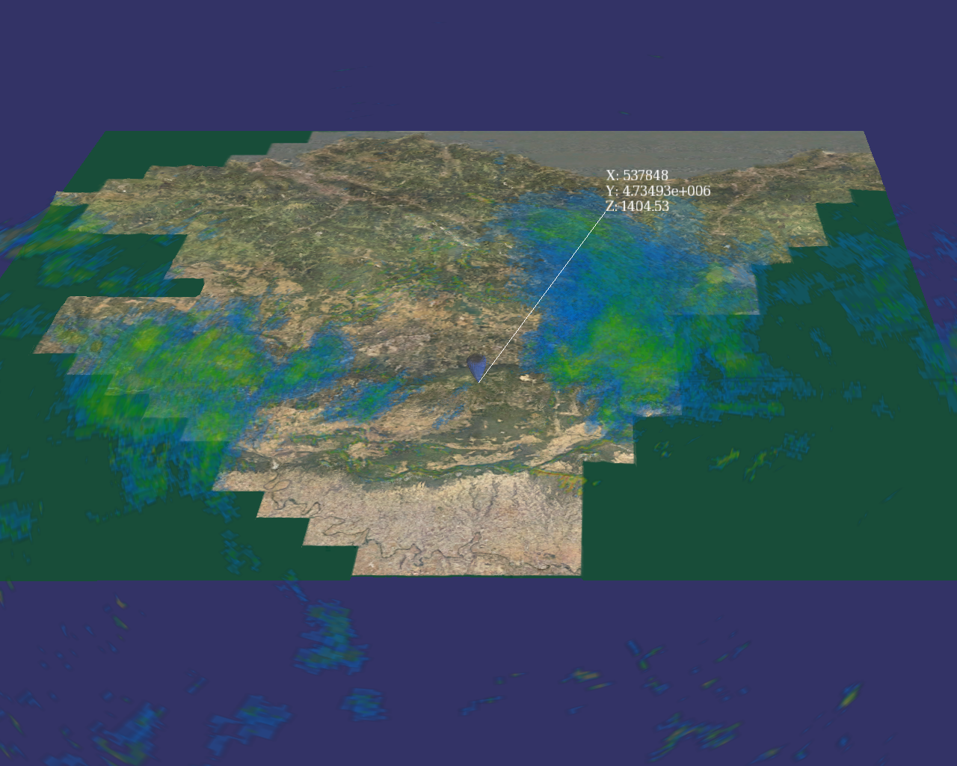
Representation and 3D visualization
Combination of Model Weather and Model Terrain
Notes:
So now, we have a model witch represents the weather of that day.
In the other hand, we have a terrain model, witch represents the vasque coutri in this case.
Bouth models are based in real world coordenades, because of, is posible to combine them directly.
Now, we can see where the clounds were that day.

Slide 7
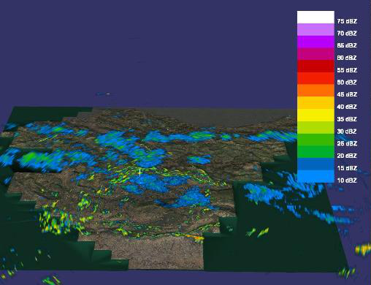
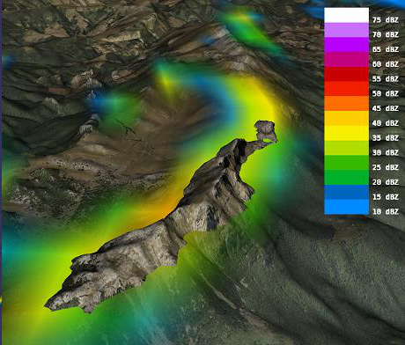
Representation and 3D visualization
Hidden information
Notes:
Con esta representación podemos ver, por ejemplo, colisiones con el terreno de forma sencilla.

Slide 8
Representation and 3D visualization
Hidden information
Notes:
Vemos video de navegación, y video de colisiones

Slide 9
Representation and 3D visualization
Immersive Representation
Notes:
We can represent the scene in a monitor or in a wall screen.
To give more information, is posible to use stereoscopic representations to express the depth of the scene.
But, when the viewer moves to other position, the image of the screen is the same.
It don’t changes the perspective, but the viewer has a different perspective.
To avoid this, we have traked the viewer, and is posible to adapt the view to the viewers position.

Slide 10
Representation and 3D visualization
Immersive Representation
Notes:
We use an asimetrick view to change the perspective.
The representation is more realistic with this adaptation,
And if we combine the stereoscopic representation and the perspective adaptation, the result is spectacular.

Slide 11
Representation and 3D visualization
Immersive Representation
Screen
Horizontal displacement

Slide 12
Gesture Interaction
Interaction devices
Wiimote
FoB
Animation actions
Gestures
Motion Capture
Positive temporal advance [Mena et al.]
Gesture matching

Slide 13
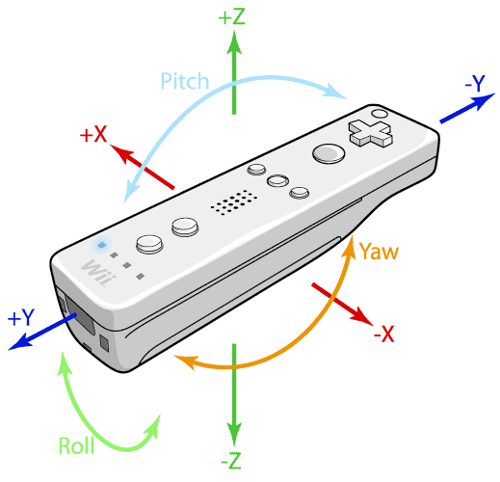
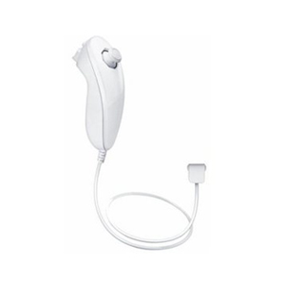
Gesture Interaction
Interaction devices
Notes:
To interact with the virtual world, we have used the Nintendo Wii Remote.
With this controller, we can change the orientation of the model, and navegate in it.
The auxiliar controller is used too.

Slide 14
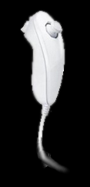
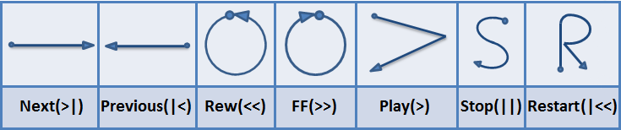
Gesture Interaction
Animation actions
Notes:
For the gesture interaction, seven gestures are defined.
Each gesture is defined as a diferent movement.
To capture this movement, the nunchuck auxiliar controller is used.

Slide 15
Gesture Interaction
Temporal Advance

Slide 16
Gesture Interaction
Temporal Advance
Samples database
Gesture Stream
Captured gesture

Slide 17
Gesture Interaction
Temporal Advance
Total of 3 positive advances
A
B
C
D
E
F
G
H
A
A
D
C
D
C
C
H
+1
+0
+1
+0
+0
+0
+0
+1
After previous match
NOT After previous match

Slide 18
Gesture Interaction
Temporal Advance
A
B
C
D
E
F
G
H
A
A
D
C
D
C
C
H
+1
+0
+1
+0
+0
+0
+0
+1
Total of 3 positive advances
After previous match
NOT After previous match
Previous match

Slide 19
Gesture Interaction
Temporal Advance
A
B
C
D
E
F
G
H
A
B
D
E
E
F
G
H
+1
+1
+1
+1
+0
+1
+1
+1
After previous match
Total of 7 positive advances
NOT After previous match

Slide 20
Gesture Interaction
Gesture Matching
Nearest Distance
Weighted Distance
Temporal Advance

Slide 21
Experimental Results
Captured data (training gestures)
Leave one out and test results
Graphical matching representation

Slide 22
Experimental Results
Captured data (training gestures)
X 5 Different Users
X 20 Repetitions
X 7 gestures
Total: 700 Gestures
Notes:
For the experiments some data samples were captured.
We used five persons gestures.
Each person had done 20 repetitions for each gesture.
If we had 7 gesetures, we have 700 samples to the database.

Slide 23
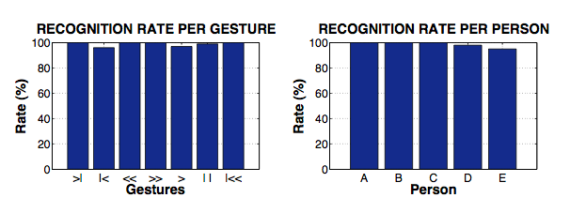
Experimental Results
Leave one out and test results
> 96%
> 95%
Notes:
With this samples, the clasification algorithm is evaluated.
A leave one out method is used to estimate the algorithms accuracy.
In this two graphs we can see the results of the test.
In the first, all data samples are used, and are divided by gesture.
In the second graph, only the gestures of one person are used vs his own samples.
There we can see that the accuracy of the algorithm is higer than 95%

Slide 24
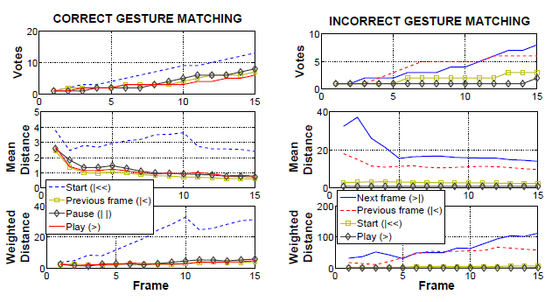
Experimental Results
Graphical matching representation
Notes:
This graphs try to represent how the matching proccess works.

Slide 25
Conclusion and Future Work
Automatic segmentation
More instruments added to the representation
Filtering and noise reduction

Slide 26


